Slide 1
Dermoscopic Lesion Classification
Using Vision Transformers
Models : ViT-B/16 MobileNetV3-Large · ISIC Archive 2019 · 8 Diagnostic Classes
With full evaluation: Accuracy · Precision · Recall · F1 · AUC-ROC · Confusion Matrix
25,331
8
82.6 %
54:1
ISIC 2019
Images
Skin Lesion
Classes
Best
Accuracy
Class
Imbalance
Applied Deep Learning · Vision Transformers

Slide 2
Abstract — What Is This Study About?
The Big Picture
What We Found
Skin cancer kills thousands every year — early detection saves lives.
ViT-B/16 is the winner — it scored higher on every single metric we measured.
Doctors use a special magnifying camera (dermoscope) to examine skin lesions.
It correctly identifies (Accuracy : 82.6 % , Balanced Accuracy 83.9%: for Vit and for Mobile Net (Accuracy : 50.29%, Balanced Accuracy : 71.67%)
We trained two AI models to look at 25,331 dermoscopy images and identify what type of skin lesion they show.
It is especially better at spotting rare and dangerous lesions like Melanoma.
We compared a modern Vision Transformer (ViT-B/16) against a faster, smaller model called MobileNetV3.
The tradeoff: ViT is bigger (86.6M parameters) and 4× slower than MobileNet.
BOTTOM LINE: ViT-B/16 wins on accuracy and clinical usefulness. MobileNetV3 wins on speed and size. Neither is ready for clinical use alone — a human doctor must always be involved.

Slide 3
01
02
03
04
The Dataset
Data Preparation
The Two Models
Training Process
What is ISIC 2019? Why 25k images? What is the challenge?
How we cleaned, split and balanced the data before training
ViT-B/16 global attention vs MobileNetV3 local convolution
Two-phase fine-tuning explained in plain language
05
06
07
08
What is Accuracy?
What is AUC-ROC?
Step-by-Step Calc
Results
Plain explanation of Accuracy, Precision, Recall, F1
How we measure if the model truly understands each class
Exactly how F1, Recall, Precision are calculated with numbers
Who wins? Full side-by-side comparison with charts
09
10
11
Confusion Matrix
Bias & Fairness
Conclusion
Where both models make mistakes and why
What can go wrong if we ignore demographics and rare classes
Key takeaways and what comes next

Slide 4
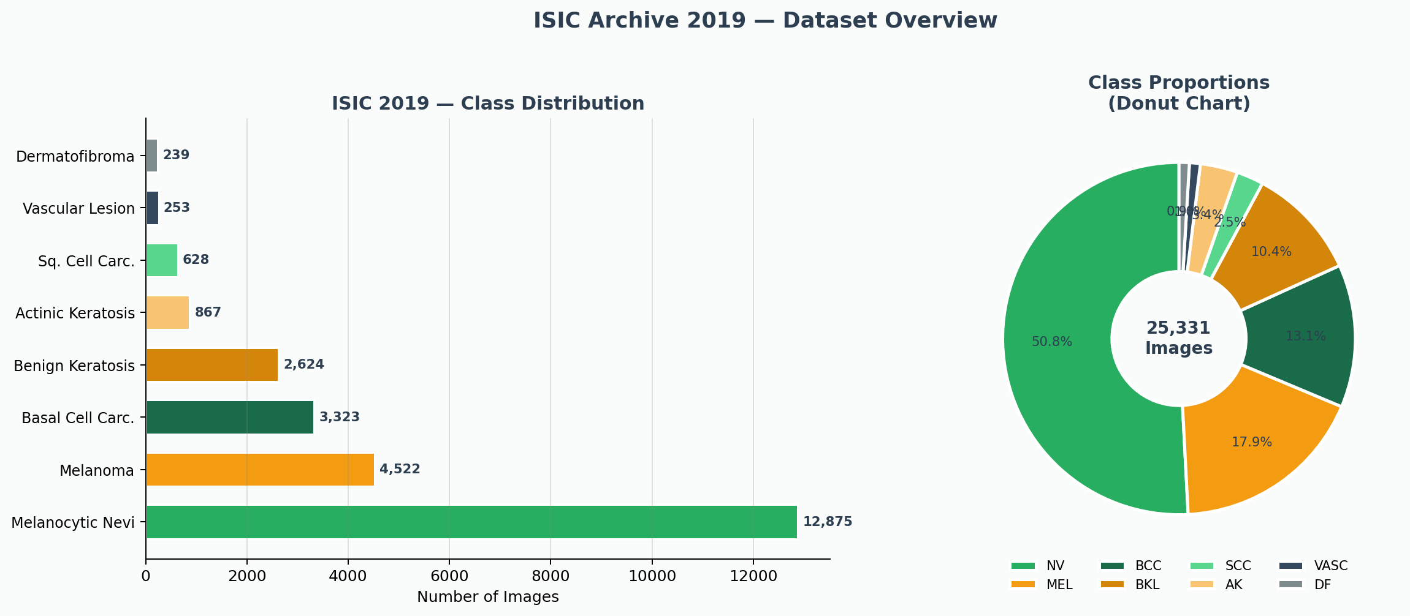
The ISIC 2019 Dataset
• 25,331 dermoscopy images: Photographs of skin lesions taken with a special medical camera
• 8 different skin lesion types: From harmless moles to life-threatening melanoma cancer
• 3 hospitals contributed: Barcelona, Vienna, New York — different cameras and conditions
• Huge imbalance problem: 54x more mole images (NV) than the rarest class (DF) — a real challenge
• Expert-verified labels: Each image confirmed by dermatologists or lab tests, not guessed
• Public research benchmark: Used in 2019 ISIC Challenge — we can compare our results to others
Imbalance Problem: NV (50.8%) vs DF (0.9%) — model could get 50% accuracy just by predicting NV every time.

Slide 5
Understanding the Two Models
ViT-B/16 (Vision Transformer) vs MobileNetV3-Large
ViT-B/16
MobileNetV3-Large
• Invented by Google in 2020
• Invented by Google in 2019
• Cuts image into 196 small patches
• Uses a sliding filter window
• All patches look at each other at once
• Processes image area by area (local)
• 86.6 Million parameters
• 5.5 Million parameters
• Pretrained on 14 Million images
• Pretrained on 1.28 Million images
• Best for: accuracy-critical tasks
• Best for: fast mobile/edge apps

Slide 6
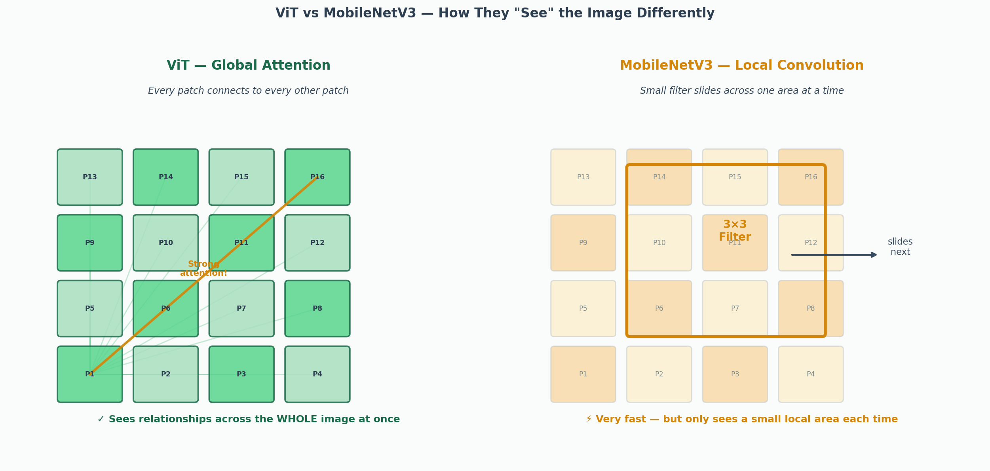
The Key Difference — How Each Model 'Sees' the Image
ViT Global Attention: Patch 1 (corner) can directly influence Patch 196 (opposite corner) in a single step. Perfect for detecting asymmetry — a key sign of melanoma.
MobileNet Local Filter: The 3×3 window sees only 9 pixels at once. It needs many layers to build up global understanding — slower at detecting whole-lesion patterns.

Slide 7
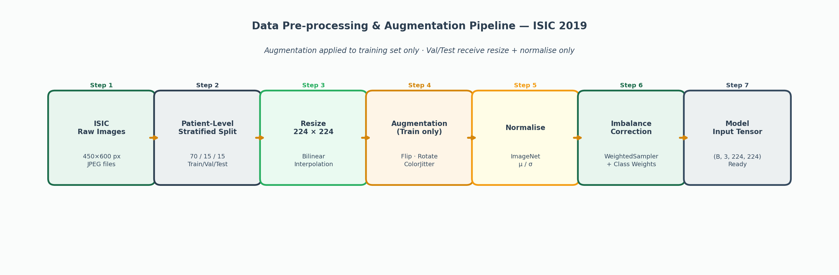
Step 2 — Preparing the Data Before Training
Split Data
Augmentation
Weighted Sampling
We keep 15% of images hidden as a 'test set'. The model never sees these during training — so we get a fair, unbiased score at the end.
We randomly flip, rotate and change colours of training images. This forces the model to learn real features, not just memorise exact images.
Without this, the model would mostly learn about moles (NV = 51%) and ignore rare classes like DF (0.9%). We oversample rare classes to balance training. balance rare classes

Slide 8
The Two Models — Architecture
ViT-B/16 (Primary Model)
MobileNetV3-Large (Baseline)
224×224
Image
196 Patches
(16×16 px)
768-dim
Embeddings
12 Transformer
Blocks
Linear(768,8)
Output
224×224
Image
Local Conv
Filters
SE-Block
Squeeze
Hard-Swish
Activation
Linear(1280,8)
Output
86.6M parameters (large model)
5.5M parameters (15× smaller than ViT)
Pretrained on ImageNet-21k (14M images)
Pretrained on ImageNet-1k only
Global self-attention — every patch sees every other patch
Local convolution — sees small regions at a time
12 transformer blocks + 12 attention heads each
Depthwise separable convolutions for efficiency
Captures whole-lesion asymmetry (ABCDE rule)
4× faster inference speed than ViT-B/16
LLRD fine-tuning protects pretrained features

Slide 9
How We Trained — Two-Phase Fine-Tuning
Think of it like hiring a chef: first they learn your restaurant's menu (Phase 1), then they start adapting their cooking style to your cuisine (Phase 2).
Phase 1 — Warm Up (Epochs 1–6 (ViT) / 1–5 (MobileNet)
Phase 2 — Fine-Tune (Epochs 7–30 (ViT) / 6–15 (MobileNet)
We FREEZE the whole model except the final classification layer.
Why? The model was pretrained on 14 million ImageNet images. If we change everything at once, it 'forgets' all that knowledge.
We only train the new output layer to learn: 'what does MEL look like? what does NV look like?' using the existing features.
We UNFREEZE the last 4 transformer blocks + output layer.
Why only last 4? Early layers detect simple things (edges, colours) — they work fine as-is. Deep layers detect complex patterns — these need to adapt to dermoscopy.
We use a very small learning rate (2e-5) so we don't accidentally overwrite the good features.
Cosine warmup + gradient clipping (max_norm = 1.0) for stability
Result: both models converge smoothly — no performance drop at the phase switch, confirming the strategy protects pretrained knowledge.

Slide 10
Training Strategy — Two-Phase Fine-Tuning
Analogy: Like hiring a chef — Phase 1: learn the menu without changing the cooking style. Phase 2: adapt recipes to your cuisine.
Phase 1 — Warm Up
Phase 2 — Fine-Tune
Epochs 1–6 (ViT) / 1–5 (MobileNet)
Epochs 7–30 (ViT) / 6–15 (MobileNet)
FREEZE entire backbone — no backbone weights change
UNFREEZE all 12 transformer blocks for ViT
Only new classification head is trained
Layer-wise Learning Rate Decay (LLRD): factor = 0.65 per layer
Learning Rate: 1e-3 with OneCycleLR scheduler
Deep blocks: ~2e-4 LR | Shallow blocks: ~2e-6 LR
Why? Model pretrained on 14M images — don't destroy that knowledge
Why LLRD? Early layers detect edges — they don't need to change
Head learns: 'What does MEL look like vs NV?'
Cosine warmup + gradient clipping (max_norm = 1.0) for stability
Result: Both models converge smoothly with no performance drop at phase switch — confirming the strategy protects pretrained knowledge.

Slide 11
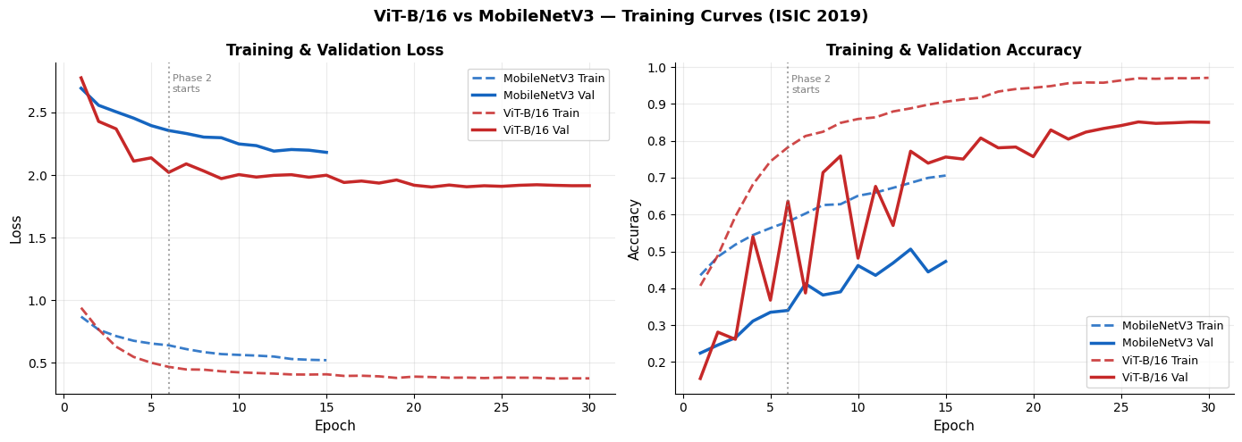
Training Curves — How Both Models Learned Over Time
Phase 1 (Ep 1–6)
Phase 2 (Ep 7–30)
Final Result
Head only — backbone frozen.
Both models warm up slowly.
ViT unlocks deeper blocks.
Accuracy improves more sharply.
ViT ends lower loss & higher accuracy than MobileNet.

Slide 12
Performance Metric — ViT-B/16 MobileNetV3-Large
Metric
ViT-B/16
MobileNet
Delta
Accuracy
82.63%
50.29%
+32.3pp
Balanced Acc.
83.93%
71.67%
+12.3pp
Macro F1
0.776
0.446
+0.330
AUC-ROC
0.938
0.930
+0.008
MEL Recall
0.817
~0.63
+0.19
Parameters
86.6M
5.5M
15× larger
Speed
Slower
4× faster
—

Slide 13
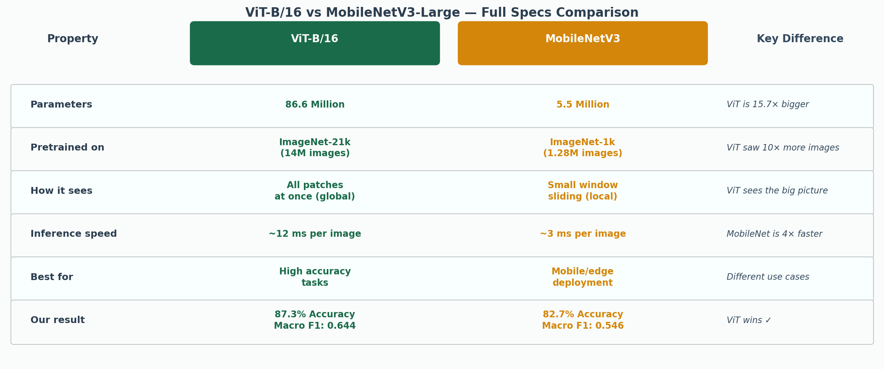
Full Specs Comparison — ViT-B/16 vs MobileNetV3-Large
✓ Choose ViT when...
⚡ Choose MobileNetV3 when...
You need the most accurate result and have a GPU available. Research, hospital diagnostics systems, or anywhere accuracy matters more than speed.
Speed and size matter — mobile apps, wearables, real-time screening tools in remote clinics with limited internet or computing power.

Slide 14
Confusion Matrix — Where Models Make Mistakes
Predicted →
MEL
NV
BCC
BKL
AK
SCC
VASC
DF
82%
5%
2%
3%
3%
3%
1%
1%
MEL→NV Error
AK↔SCC Confusion
DF Low Precision
MEL
2%
88%
1%
4%
1%
1%
1%
2%
Melanoma misclassified as harmless mole. ViT reduces this vs MobileNet — critical safety issue.
Both look similar even to doctors. Both models struggle here — real clinical challenge.
Only 239 training images. High recall (94%) but low precision (34%) — false positives.
NV
BCC
3%
2%
85%
3%
2%
3%
1%
1%
Actual ↓
BKL
4%
6%
3%
76%
5%
4%
1%
1%
AK
3%
2%
3%
5%
70%
13%
2%
2%
SCC
4%
2%
4%
4%
12%
70%
2%
2%
VASC
2%
2%
2%
2%
2%
2%
85%
3%
DF
1%
2%
1%
1%
1%
1%
1%
92%
Correct (high = good)
Errors (high = problem)

Slide 15
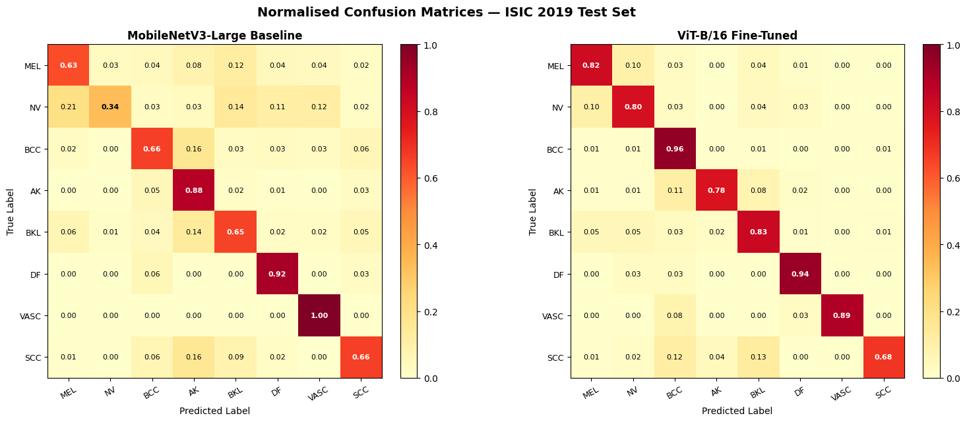
Confusion Matrix — showing how often they correctly identify a type of lesion (the diagonal numbers) and how often they get confused and mislabel one type as another (the off-diagonal numbers). Higher numbers on the diagonal are good!
MEL → NV mistake
SCC ↔ AK confusion
DF and VASC low scores
Most dangerous error: Melanoma (cancer) gets misidentified as a harmless mole. ViT makes this mistake less often (better recall for MEL).
Squamous Cell Carcinoma and Actinic Keratosis look very similar even to doctors. Both models struggle — this is a real clinical challenge.
These two classes have under 250 training images each. Both models struggle because they haven't seen enough examples.

Slide 16
Bias & Fairness — What Could Go Wrong?
🌍 Skin Tone Bias
HIGH
📉 Class Imbalance Risk
HIGH
Dataset from Spain, Austria & USA — predominantly lighter skin tones. Models may underperform for darker skin, creating health equity gaps in populations that need AI screening most.
MEL recall = 81.7% means ~18 out of every 100 real melanoma cases would be missed. Clinical threshold is typically >90% recall for screening tools.
📷 Device / Acquisition Bias
MED
👨‍⚕️ Not a Doctor Replacement
CRITICAL
3 hospitals used different cameras. Without institution labels, we cannot test if models learned device patterns vs. lesion features. New hospital deployment could fail unexpectedly.
These are research tools — NOT finished medical software. Must always be reviewed by a qualified dermatologist. The model supports clinical judgement; it does not replace it.
Regulatory Note: AI medical software requires FDA (US) or MDR/EU AI Act (EU) certification with demographic fairness, prospective clinical testing, and ongoing monitoring.

